Slide 1
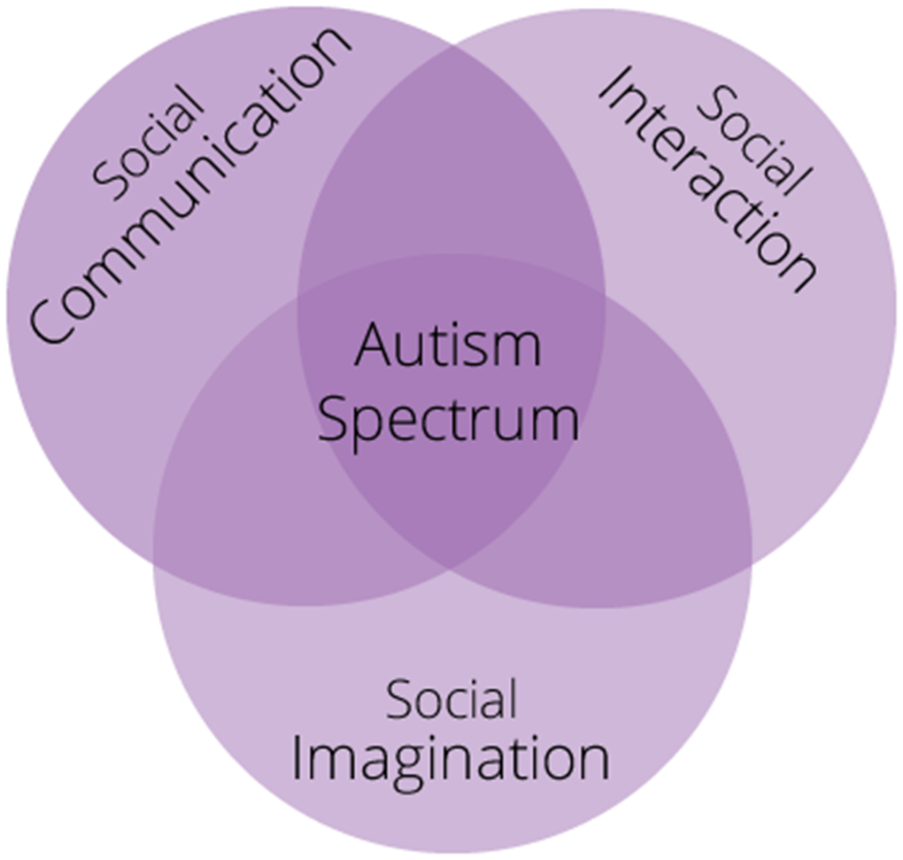
Out of Date!!!!!
Autism Asperger syndrome
Lower IQ Average/higher IQ
No or little language Fairly good language ability
Childhood autism High functioning autism
Learning disabled Mild Autism

